Slide 1






Voting Web Application Using Django Framework
Student Details
Name: Abinesh K
NM Id: 922221104002
College Name : Theni Kammavar Sangam College of Technology

Slide 2
Voting Web Application Using Django Framework
Disclaimer
The content is curated from online/offline resources and used for educational purpose only

Slide 3

Course Outline
Voting Web Application Using Django Framework
Abstract
Problem Statement
Aims&Objective
Result
Conclusion

Slide 4


Voting Web Application Using Django Framework
Abstract
The proposed project aims to develop a secure and user-friendly online voting web application using the Django framework. In today's digital age, traditional voting methods are often cumbersome and time-consuming. By leveraging web technologies, we can create a platform that enables efficient and accessible voting processes while ensuring the integrity and security of the voting system.

Slide 5


Voting Web Application Using Django Framework
Problem Statement
The objective of this project is to create a secure, user-friendly, and scalable web application that facilitates various types of voting processes, such as elections, surveys, and polls.
The application should provide an intuitive interface for both voters and administrators while ensuring the integrity and confidentiality of the voting process.

Slide 6

Voting Web Application Using Django Framework
Aim and Objective
Aim: The aim of this project is to develop a secure and user-friendly web application using Django, allowing registered users to participate in various voting activities. The application will provide features for users to create, view, and vote on different topics, with real-time updates of voting results. Additionally, an administration panel will be implemented to manage voting topics and user accounts. The application will prioritize security measures to prevent unauthorized access and ensure the integrity of the voting process. User interaction and engagement will be facilitated through features like commenting and sharing, creating an interactive voting experience for users."

Slide 7
Voting Web Application Using Django Framework
Objectives
User Authentication and Management:
Implement user registration, login, and logout functionalities.
Ensure password encryption and secure authentication mechanisms.
Allow users to update their profiles and reset passwords if forgotten.
Voting System Functionality:
Enable users to view a list of available voting topics and options.
Implement the ability for users to cast their votes for different options.
Ensure that each user can only vote once per topic.
Provide real-time updates of voting results to users.
Administration Panel:
Create an administrative interface for managing voting topics and options.
Allow administrators to add, edit, and delete voting topics and options.
Implement user management features for administrators to manage user accounts and permissions.
Security Measures:
Implement measures to prevent fraudulent voting, such as CAPTCHA or IP restrictions.
Ensure that user authentication and data transmission are secure using HTTPS.
Protect against common security vulnerabilities like SQL injection and cross-site scripting (XSS) attacks.

Slide 8
Voting Web Application Using Django Framework
User Interaction and Engagement:
Enable users to comment on voting topics and engage in discussions.
Implement features like upvoting or downvoting comments to encourage participation.
Provide social sharing options to allow users to share voting topics on social media platforms.
Accessibility and Responsiveness:
Design the application to be accessible to users with disabilities, following WCAG guidelines.
Ensure that the user interface is responsive and compatible with various devices and screen sizes.
Testing and Quality Assurance:
Write unit tests to ensure the functionality of different components, including user authentication and voting features.
Conduct integration tests to verify the interaction between different modules and components.
Perform usability testing to ensure that the application meets the needs of its target users.
Documentation and Support:
Provide comprehensive documentation for users and administrators on how to use the application.
Include a FAQ section to address common questions and issues.
Offer user support through email or a dedicated support system to assist users with any problems they encounter.

Slide 9
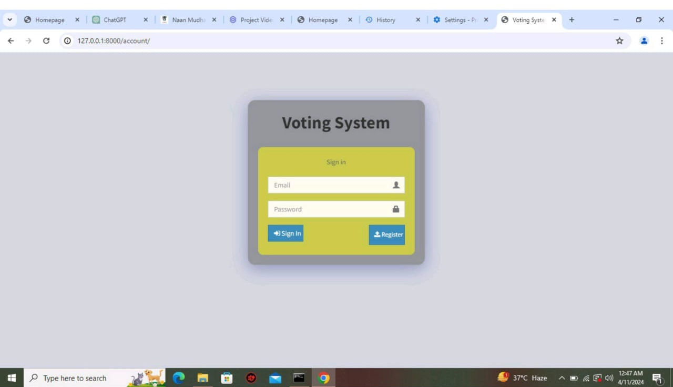
Voting Web Application Using Django Framework
Result
Notes:
9

Slide 10
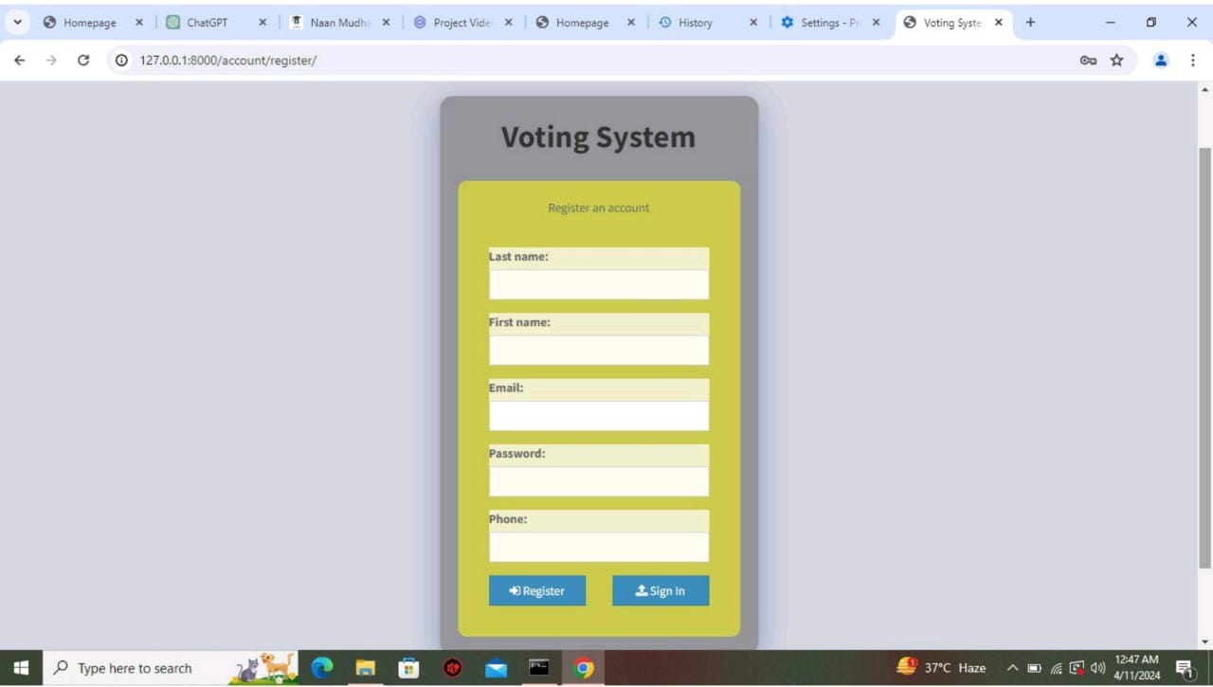
Voting Web Application Using Django Framework

Slide 11
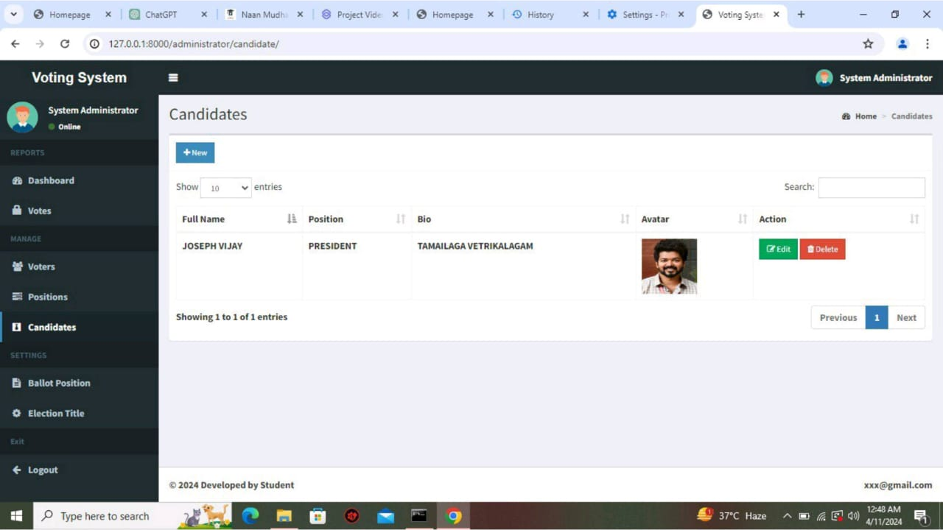
Voting Web Application Using Django Framework

Slide 12
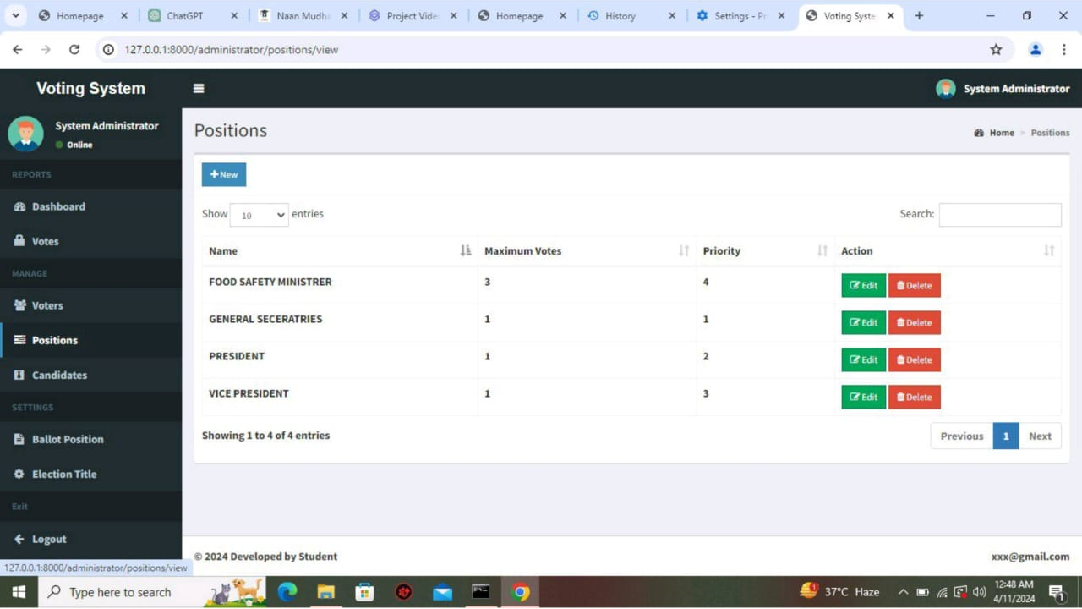
Voting Web Application Using Django Framework

Slide 13
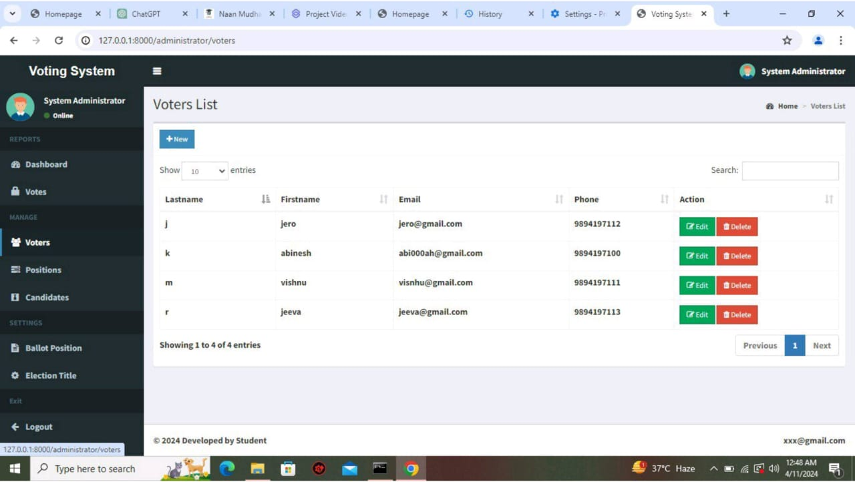
Voting Web Application Using Django Framework

Slide 14
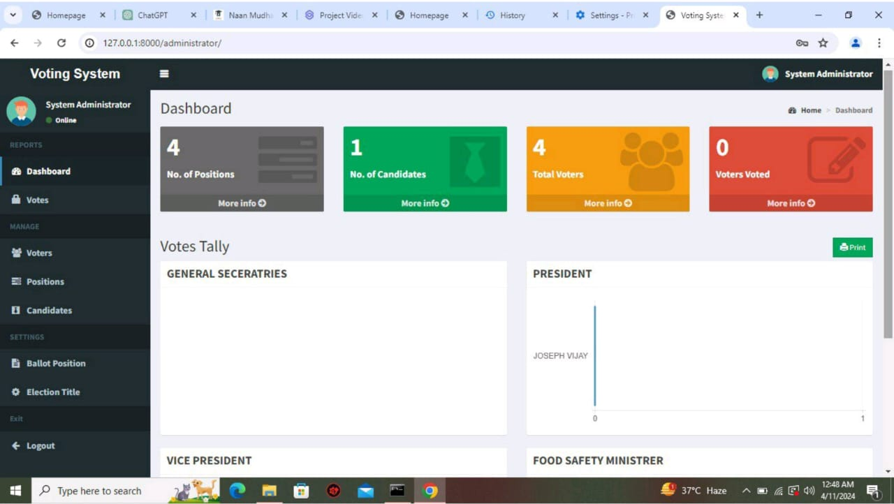
Voting Web Application Using Django Framework

Slide 15

Voting Web Application Using Django Framework
Conclusion
In summary, developing a voting web application using the Django framework offers a streamlined and efficient approach to creating a secure, interactive, and user-friendly platform.
By leveraging Django's robust features for user authentication, data management, and administrative control, coupled with responsive design and security measures, the application can provide a seamless voting experience for users while ensuring the integrity and confidentiality of the voting process.
With its scalability, flexibility, and accessibility, a Django-based voting web application stands as a versatile solution for facilitating democratic participation and engagement in various settings.
Notes:
15

Slide 16
Voting Web Application Using Django Framework
Thank you!
Notes:
16

